Slide 1
CSP571 Data Preparation and Analysis
Lecture 9. Dimensionality Reduction and Unsupervised Learning
Oleksandr Narykov
onarykov@iit.edu

Slide 2
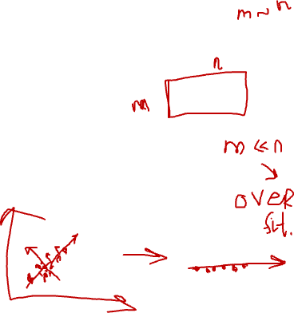
Principal Component Analysis
Given a dataset 𝒙 with 𝑑 dimensions, project it into 𝑘 dimensions (𝑘 < 𝑑) with minimum loss of information
𝒛 = 𝒘^{𝑇}𝒙
Principal component analysis (PCA) maximizes the variance in the projected space so that objects are spread out
𝑎𝑟𝑔𝑚𝑎𝑥_{𝒘}𝑉𝑎𝑟(𝒛)
7

Slide 3
PCA Objective
𝒛 = 𝒘^{𝑇}𝒙
𝑎𝑟𝑔𝑚𝑎𝑥_{𝒘}𝑉𝑎𝑟(𝒛)
Reminder: 𝑉𝑎𝑟 𝑎𝑋 + 𝑏
𝑉𝑎𝑟 𝒛 = 𝒘^{𝑇}𝑉𝑎𝑟(𝒙)𝒘
= 𝑎²𝑉𝑎𝑟(𝑋)
We can trivially maximize variance by multiplying w by a large constant; hence, we enforce that 𝒘 is unit length
𝒘𝒘^{𝑇} = 1
Objective
maximize 𝒘^{𝑇}𝑉𝑎𝑟(𝒙)𝒘 subject to 𝒘𝒘^{𝑇} = 1
8

Slide 4
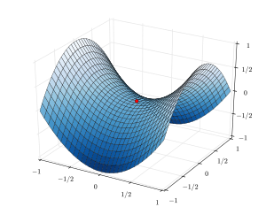
Background – Constrained optimization
Find θ
maximizing f (θ) subject to
c₁ (θ) = 0
...
c_{m} (θ) = 0
Form the Lagrangian:
𝒘𝒘^{𝑇} = 1
F (θ, λ) = f (θ) − ∑λ_{j}c_{j} (θ)
j =1
m
9

Slide 5
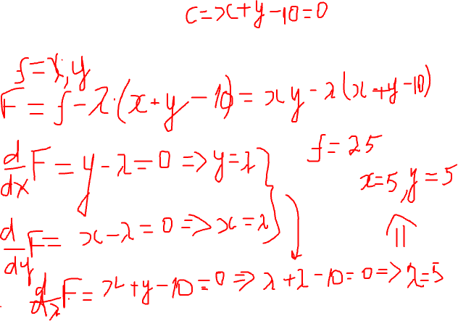
Example
Maximize 𝑥𝑦 subject to 𝑥 + 𝑦 = 10
Notes:
xy – lam (x+y-10)
d/dx
d/dy
d/dlam

Slide 6
PCA with One Dimension
maximize 𝑉𝑎𝑟 𝑧₁ = 𝑤^{𝑇}𝑉𝑎𝑟 𝒙 𝑤₁ subject to 𝑤^{𝑇}𝑤₁ = 1
1 1
Let the variance of 𝒙 be the covariance matrix Σ
Objective
Maximize 𝑤^{𝑇}Σ𝑤₁ subject to 𝑤^{𝑇}𝑤₁ = 1
1 1
Lagrange
maximize 𝑤^{𝑇}Σ𝑤₁ − 𝜆(𝑤^{𝑇}𝑤₁ − 1)
1 1
Take derivative with respect to 𝑤₁, set to zero
2Σ𝑤₁ − 2𝜆𝑤₁ = 0
Σ𝑤₁ = 𝜆𝑤₁
𝑤₁ is an eigenvector and 𝜆 is an eigenvalue of Σ
Because we maximize variance
maximize 𝑤^{𝑇}Σ𝑤₁ = 𝑤^{𝑇}𝜆𝑤₁ = 𝜆𝑤^{𝑇}𝑤₁ = 𝜆
1 1 1
𝑤₁is the eigenvector that corresponds to the largest eigenvalue of Σ
11

Slide 7
PCA with 𝑘 Dimensions
We want the second vector 𝑤₂ to be orthogonal to
𝑤₁ so that the 𝑧₂ is uncorrelated with 𝑧₁
Skipping the derivation details
𝑤₁ is the eigenvector for the largest eigenvalue 𝜆₁
𝑤₂ is the eigenvector for the second largest eigenvalue 𝜆₂
…
𝑤_{𝑘} is the eigenvector for the 𝑘^{𝑡ℎ} largest eigenvalue 𝜆_{𝑘}
In the end, the transformation is typically
centered around zero (in the new dimensions)
𝒛 = 𝐰^{T}(𝐱 − 𝐦) where 𝒎 is the mean of 𝒙
12

Slide 8
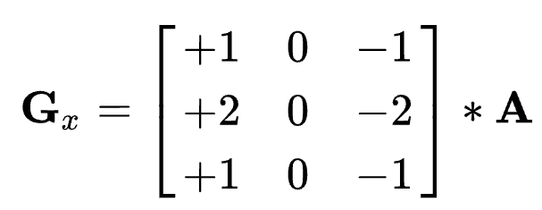
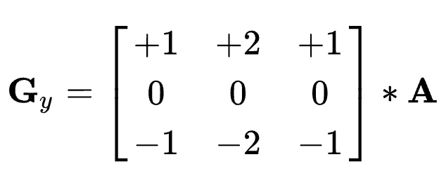
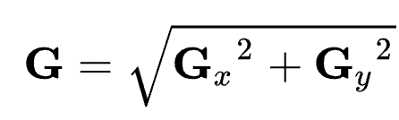
Feature Engineering
Using domain knowledge to transform data
Sobel operator in Computer Vision
5

Slide 9
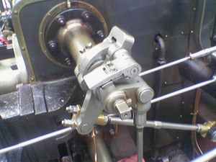
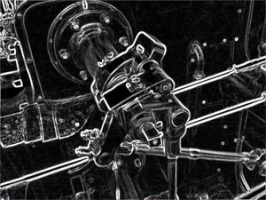
Feature Engineering
Using domain knowledge to transform data
Sobel operator in Computer Vision
5

Slide 10
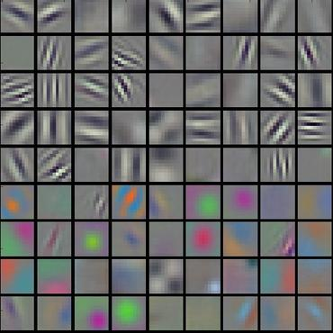
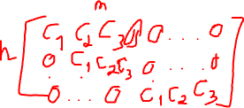
Convolution Network
End-to-end learning
Deep learning is representation learning
Weight matrices of hidden layers of convolution network

Slide 11
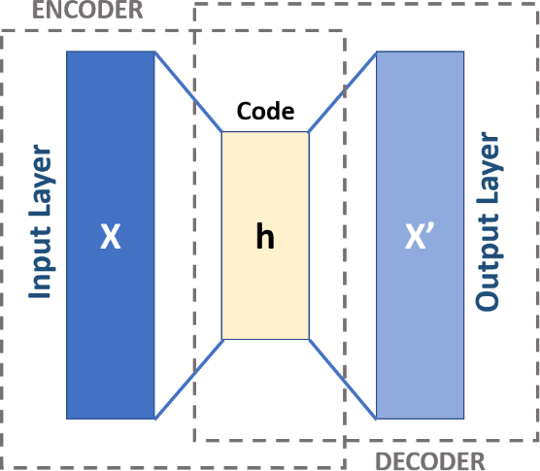

AutoEncoder
A neural network architecture where the input and output are the same
𝒙 → 𝒉 → 𝒙
Input x is encoded into h, where h is typically lower dimensional than x and h is decoded back to x, with some error
14
https://upload.wikimedia.org/wikipedia/commons/3/37/Autoencoder_schema.png

Slide 12
Other DL Methods
Transformers
Contrastive learning
…
International conference on learning representations (ICLR)
https://iclr.cc/
15

Slide 13
Unsupervised Learning

Slide 14
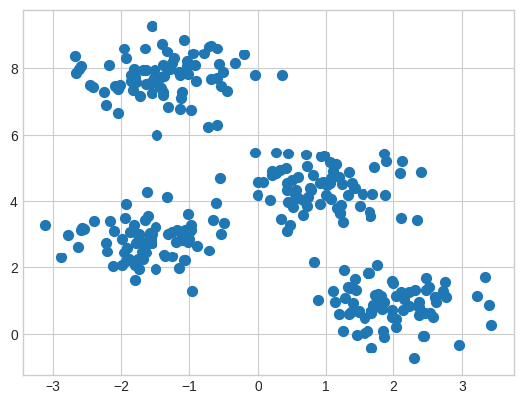
Clustering
Intuitively, clusters are the groups in the data for which points within the same group are more similar than the points from different groups
Mathematically, groups
of points are usually con-
sidered clusters when they
Form high-density regions
in a data space
2

Slide 15
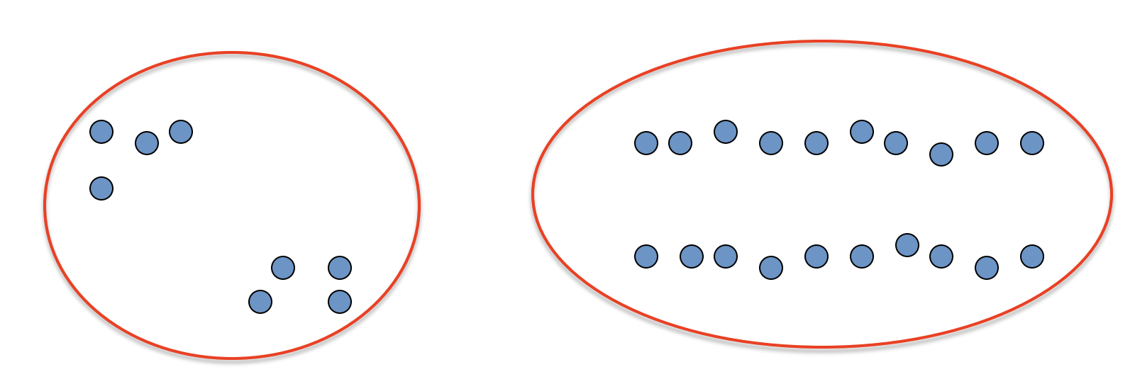
Clustering
Basic idea: group together similar instances
Example: 2D point patterns
2

Slide 16
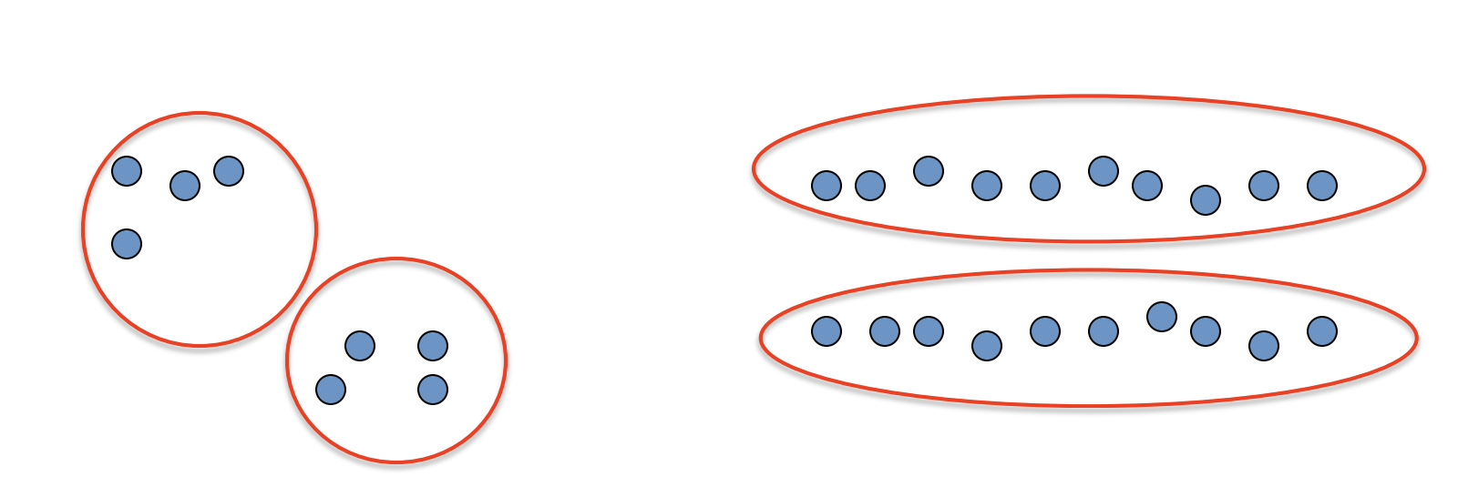
Clustering
Basic idea: group together similar instances
Example: 2D point patterns
2

Slide 17
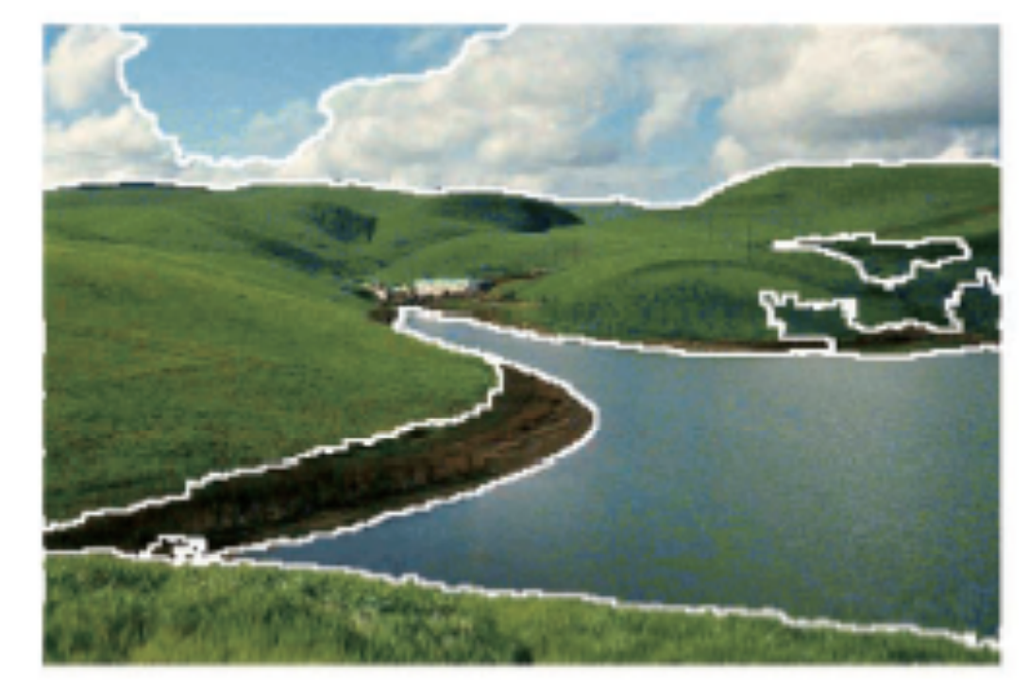
Examples
Image segmentation
2

Slide 18
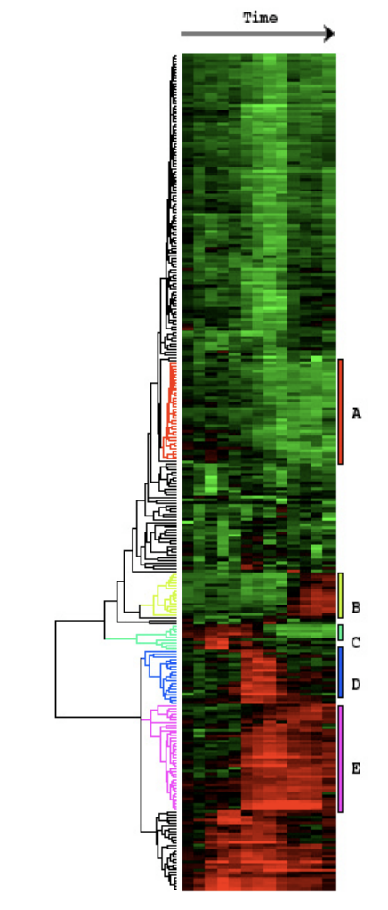
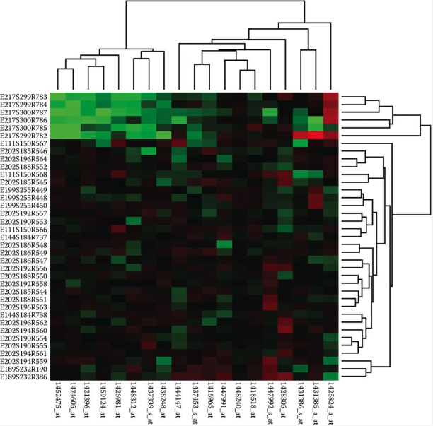
Examples
Gene expression
2

Slide 19
Various Approaches
K-Means
Expectation Maximization (EM)
EM is a general approach that can be used for many
other tasks, one of which is clustering
Hierarchical clustering
DBScan
Spectral clustering
Mean-shift
… and many more
3

Slide 20
We’ll Cover
K-Means
Expectation Maximization for mixture of Gaussians
Spectral clustering
Hierarchical clustering
4

Slide 21
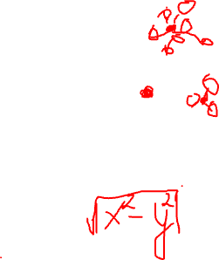
K-Means
Basic idea: given data, find k prototype vectors, and assign each data point to its closest prototype vector, such that the sum of the distances to the closest prototype vectors is minimized
𝑁
𝑗=1
Let 𝐷 = 𝑥
𝑘
𝑖=1
be the data and let 𝑚
be the
𝑗
𝑖
prototype vectors. Objective:
minimize ∑^{𝑁} min 𝑑𝑖𝑠𝑡𝑎𝑛𝑐𝑒 𝑥_{𝑗}, 𝑚_{𝑖}
𝑗=1
𝑖
A typical distance metric is Euclidan distance
5

Slide 22
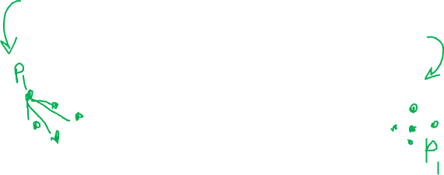
K-Means
Initialize k centers 𝑚_{𝑖}
𝑘
𝑖=1
Repeat until convergence
Assign each data point 𝑥_{𝑗} to the closest cluster center
Re-compute each center 𝑚_{𝑖}
𝑘
𝑖=1
as the mean of the
points that are assigned to that center
6

Slide 23
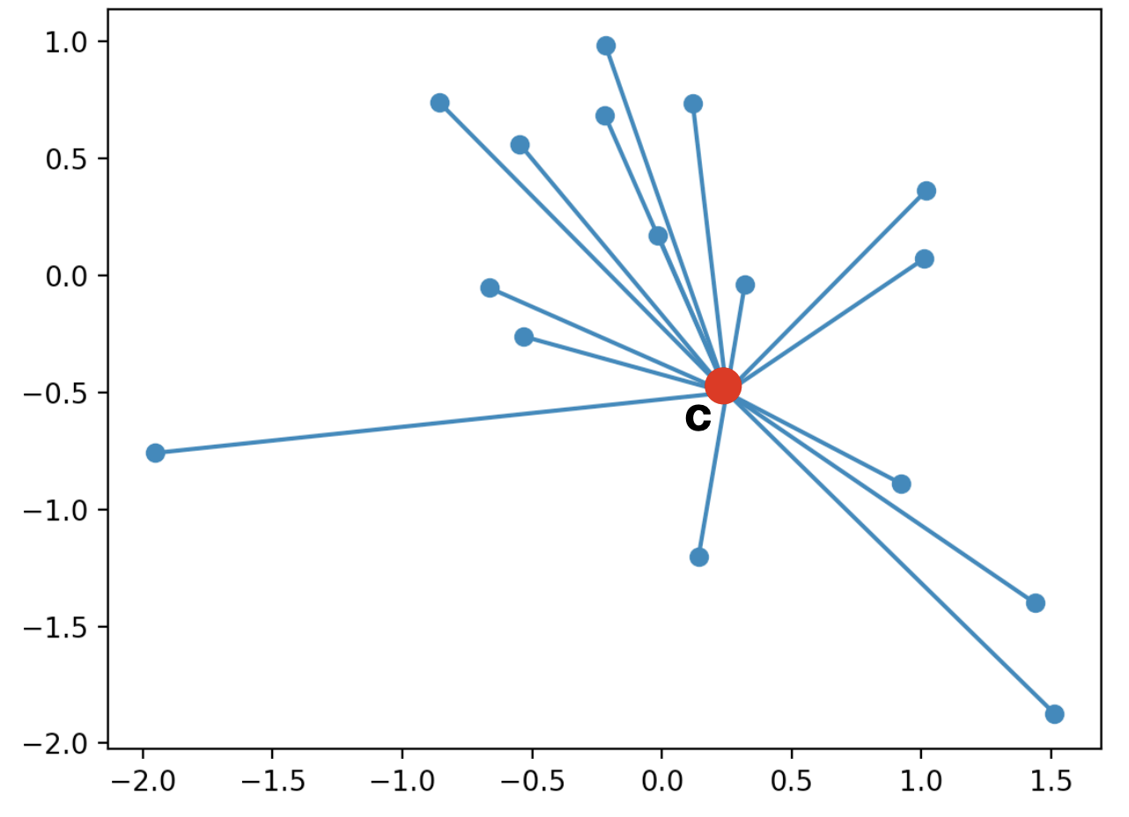
K-Means
Cluster centroid
6

Slide 24
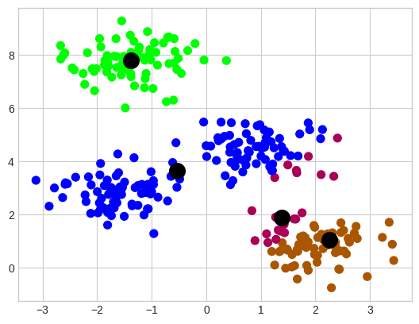
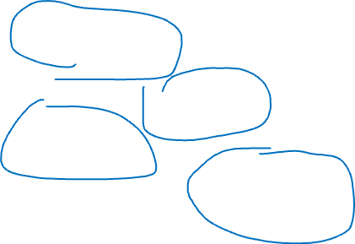
K-Means
Randomly initialized cluster centers
6

Slide 25
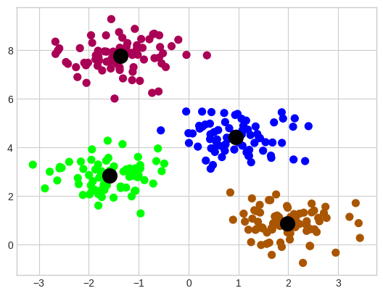
K-Means
Algorithm output after convergence (colors are changed)
6

Slide 26
K-Means
Algorithm output after convergence (colors are changed)
6

Slide 27
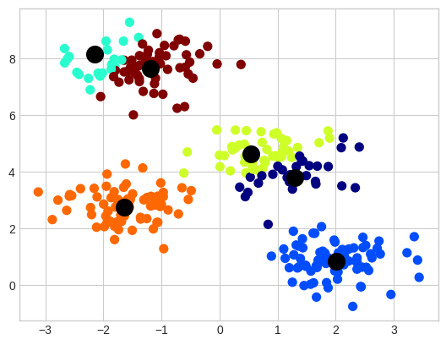

K-Means
Output of the K-Means with 6 clusters
6

Slide 28
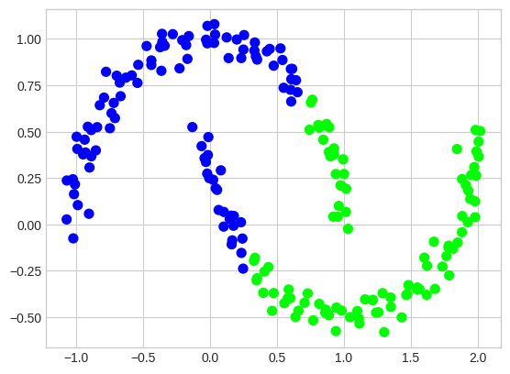
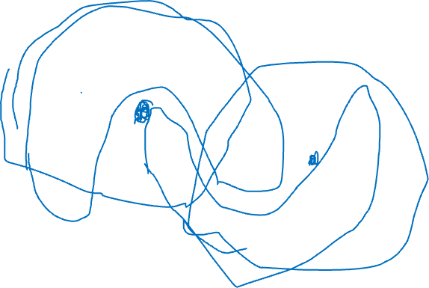
K-Means
Important assumption – clusters are convex
6

Slide 29
K-Means Summary
Guaranteed to converge in a finite number of iterations
Requires specifying the number of clusters beforehand
No guarantee for convergence to the global minimum
Output is highly dependent on the initial centroids
Sometimes, clusters can become empty
6

Slide 30
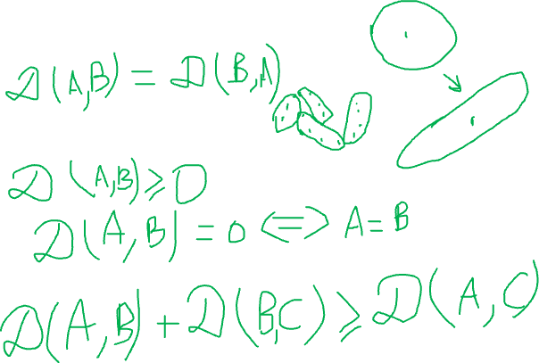
Generalizing Distance Measure
Symmetry
Positivity and self-similarity
Triangle inequality
6

Slide 31
EM for Mixture of Gaussians
Basic idea: very much like the Bayes classifier where we have P(C) and p(x|C) and we use that for computing P(C|x), except, in this case, classes are not given to us. So, we take an iterative approach
Repeat until convergence
Assign data points to classes/centers/components, probabilistically (i.e., compute P(C|x) using P(C) and p(x|C) ) – Expectation
Re-estimate class/center/component parameters based on the probabilistic assignments to classes/centers (i.e., recompute P(C) and p(x|C) using the probabilistic assignments) – Maximization
7

Slide 32
Notation
𝑃 𝐶_{𝑖} : prior probability of component 𝐶_{𝑖}
A multinomial distribution
𝑃 𝑥_{𝑗} 𝐶_{𝑖} : probability that component 𝐶_{𝑖} generated 𝑥_{𝑗}
A Gaussian distribution with mean 𝜇_{𝑖} and variance 𝜎²
𝑖
This can be easily generalized to multivariate Gaussian distribution with mean 𝜇_{𝑖} and co-variance Σ_{𝑖}
𝑃 𝐶_{𝑖} 𝑥_{𝑗} : probability that 𝑥_{𝑗} belongs to component 𝐶_{𝑖}
Via Bayes rule, 𝑃 𝐶_{𝑖} 𝑥_{𝑗} ∝ 𝑃 𝑥_{𝑗} 𝐶_{𝑖} 𝑃 𝐶_{𝑖}
𝑛_{𝑖}: Expected number of instances that belong to component 𝐶_{𝑖}
𝑛_{𝑖} = ∑^{𝑁} 𝑃 𝐶_{𝑖} 𝑥_{𝑗}
𝑗=1
8

Slide 33
EM
E step: compute cluster/component assignments
𝑃 𝐶_{𝑖} 𝑥_{𝑗} ∝ 𝑃 𝑥_{𝑗} 𝐶_{𝑖} 𝑃 𝐶_{𝑖}
M step: recompute parameters
𝑛_{𝑖} = ∑^{𝑁} 𝑃 𝐶_{𝑖} 𝑥_{𝑗}
𝑗=1
Weighted counts, where weights are 𝑃 𝐶_{𝑖} 𝑥_{𝑗}
𝑃 𝐶
₌ 𝑛_{𝑖}
𝑖
𝑁
𝑃 𝑥_{𝑗} 𝐶_{𝑖} ∼ Ν 𝜇_{𝑖}, 𝜎²
𝑖
∑𝑁
𝑃 𝐶 𝑥 𝑥_{𝑗}
𝜇_{𝑖} =
𝑗=1
𝑖 𝑗
𝑛
𝑖
Weighted mean, where weights are 𝑃 𝐶_{𝑖} 𝑥_{𝑗}
2
∑𝑁
𝑃 𝐶 𝑥 𝑥 −𝑚
𝑗=1
𝑖 𝑗
𝑗 𝑖
𝜎 ² =
𝑖
𝑛_{𝑖}
9
Weighted variance, where weights are 𝑃 𝐶_{𝑖} 𝑥_{𝑗}

Slide 34
EM
E step: compute cluster/component assignments
𝑃 𝐶_{𝑖} 𝑥_{𝑗} ∝ 𝑃 𝑥_{𝑗} 𝐶_{𝑖} 𝑃 𝐶_{𝑖}
M step: recompute parameters
𝑛_{𝑖} = ∑^{𝑁} 𝑃 𝐶_{𝑖} 𝑥_{𝑗}
𝑗=1
Weighted counts, where weights are 𝑃 𝐶_{𝑖} 𝑥_{𝑗}
𝑃 𝐶
₌ 𝑛_{𝑖}
𝑖
𝑁
𝑃 𝑥_{𝑗} 𝐶_{𝑖} ∼ Ν 𝜇_{𝑖}, 𝜎²
𝑖
∑𝑁
𝑃 𝐶 𝑥 𝑥_{𝑗}
𝜇_{𝑖} =
𝑗=1
𝑖 𝑗
𝑛
𝑖
Weighted mean, where weights are 𝑃 𝐶_{𝑖} 𝑥_{𝑗}
2
∑𝑁
𝑃 𝐶 𝑥 𝑥 −𝑚
𝑗=1
𝑖 𝑗
𝑗 𝑖
𝜎 ² =
𝑖
𝑛_{𝑖}
9
Weighted variance, where weights are 𝑃 𝐶_{𝑖} 𝑥_{𝑗}

Slide 35
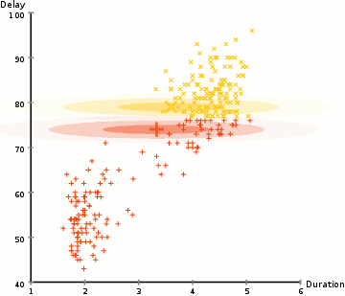
EM
https://upload.wikimedia.org/wikipedia/commons/6/69/EM_Clustering_of_Old_Faithful_data.gif
9

Slide 36
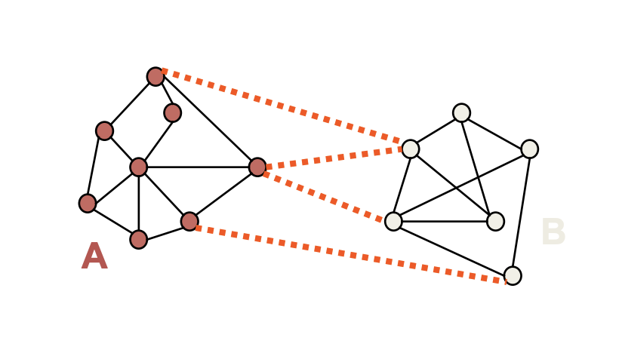
Spectral Clustering
EM and K-Means are limited by data shape assumptions
Potential solution: assign points that are close to each other to the same cluster
9

Slide 37
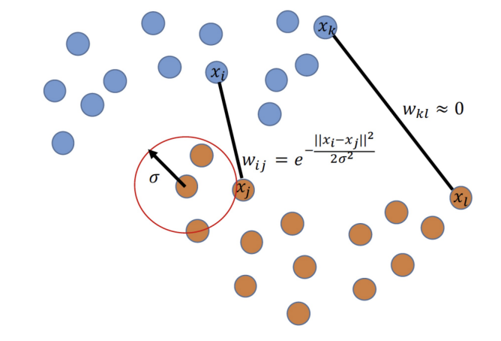
Spectral Clustering
Basic idea: group samples based graph communities
We need to construct a graph over datapoints
Similarity graph with a Gaussian kernel is a common approach
9

Slide 38
Spectral Clustering
Let’s separate the graph in two parts
Min-cut algorithm
Min-cut
Preferred cut
9

Slide 39
Spectral Clustering
Let’s separate the graph in two parts
Min-cut algorithm
Min-cut
Preferred cut
9

Slide 40
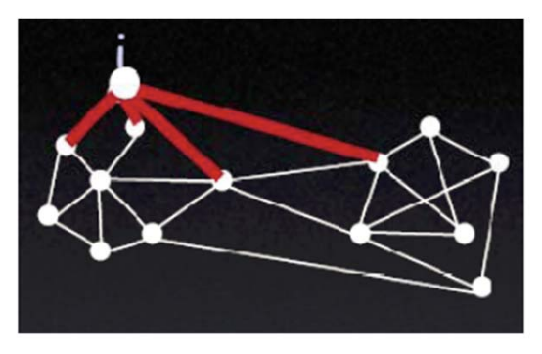
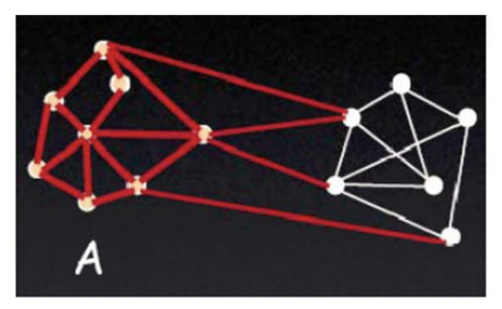
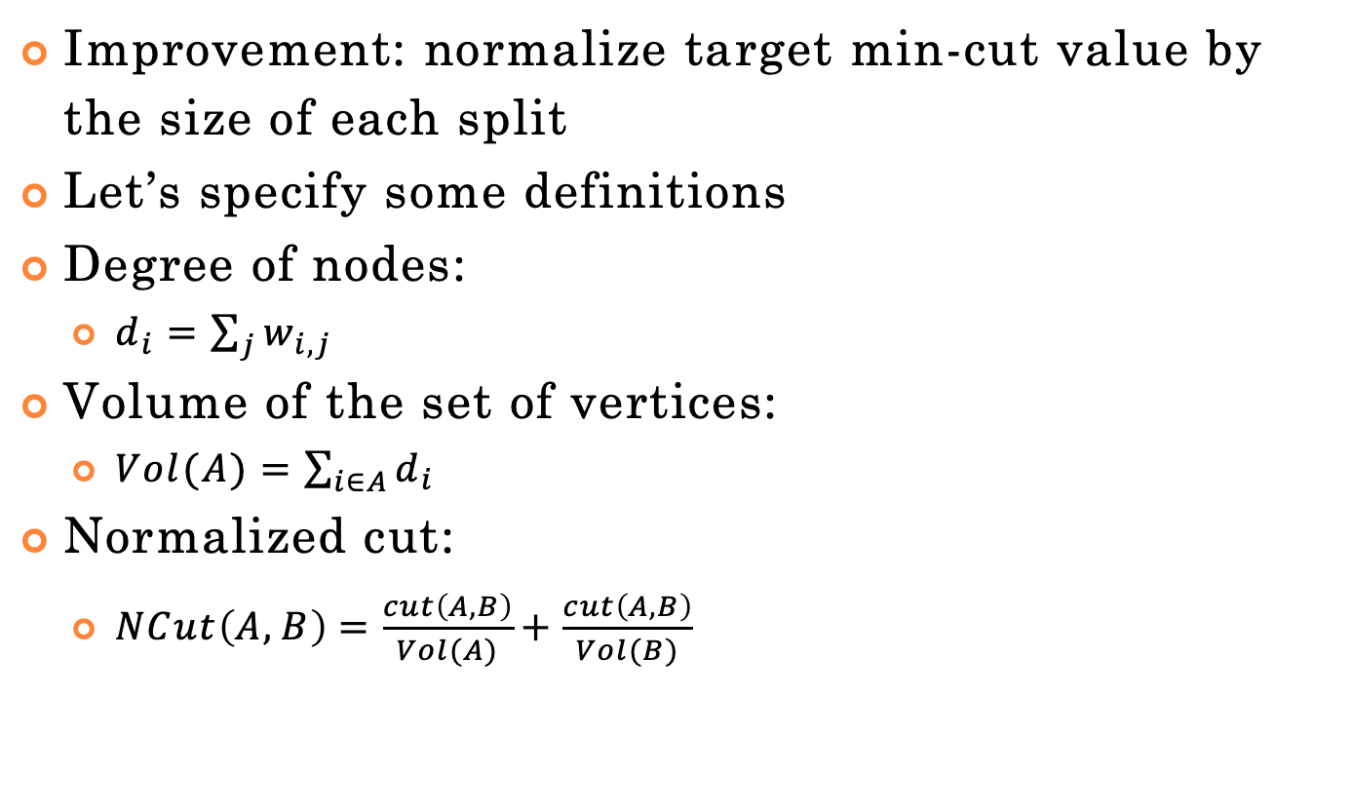
Spectral Clustering
Improvement: normalize target min-cut value by the size of each split
Let’s specify some definitions
Degree of nodes:
$d_{i}=\sum_{j}{w_{i,j}}$
Volume of the set of vertices:
$Vol(A)=\sum_{i∈A}{d_{i}}$
Normalized cut:
$NCut\left(A,B\right)=\frac{cut\left(A,B\right)}{Vol(A)}+\frac{cut\left(A,B\right)}{Vol(B)}$
https://people.csail.mit.edu/dsontag/
9

Slide 41
Spectral Clustering
Improvement: normalize target min-cut value by the size of each split
Let’s specify some definitions
Degree of nodes:
$d_{i}=\sum_{j}{w_{i,j}}$
Volume of the set of vertices:
$Vol(A)=\sum_{i∈A}{d_{i}}$
Normalized cut:
$NCut\left(A,B\right)=\frac{cut\left(A,B\right)}{Vol(A)}+\frac{cut\left(A,B\right)}{Vol(B)}$
https://people.csail.mit.edu/dsontag/
9

Slide 42
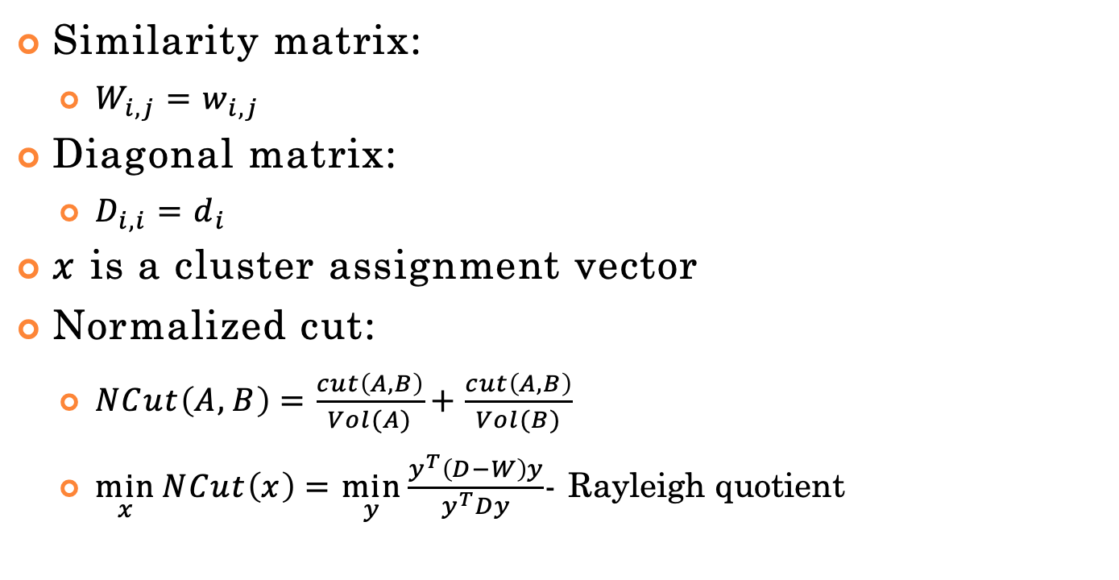
Spectral Clustering
Similarity matrix:
$W_{i,j}=w_{i,j}$
Diagonal matrix:
$x$ is a cluster assignment vector
Normalized cut:
$NCut\left(A,B\right)=\frac{cut\left(A,B\right)}{Vol(A)}+\frac{cut\left(A,B\right)}{Vol(B)}$
$\min_{x}{NCut\left(x\right)}=\min_{y}{\frac{y^{T}\left(D−W\right)y}{y^{T}Dy}}$- Rayleigh quotient
9

Slide 43
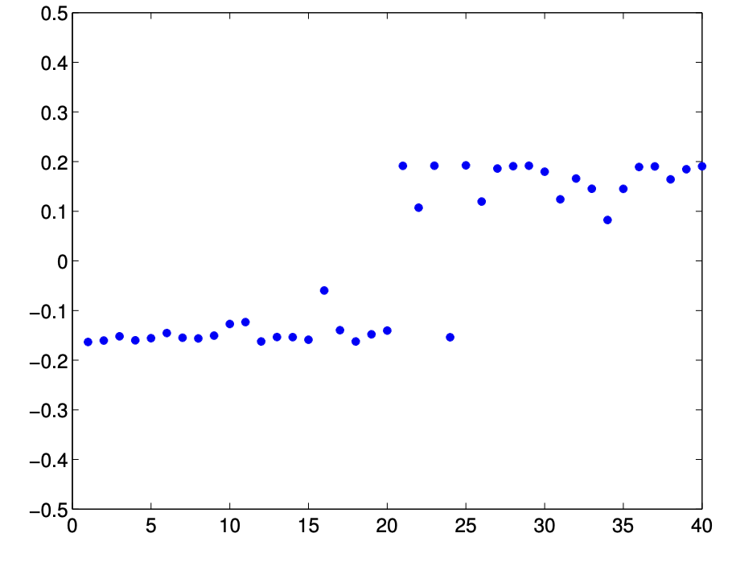
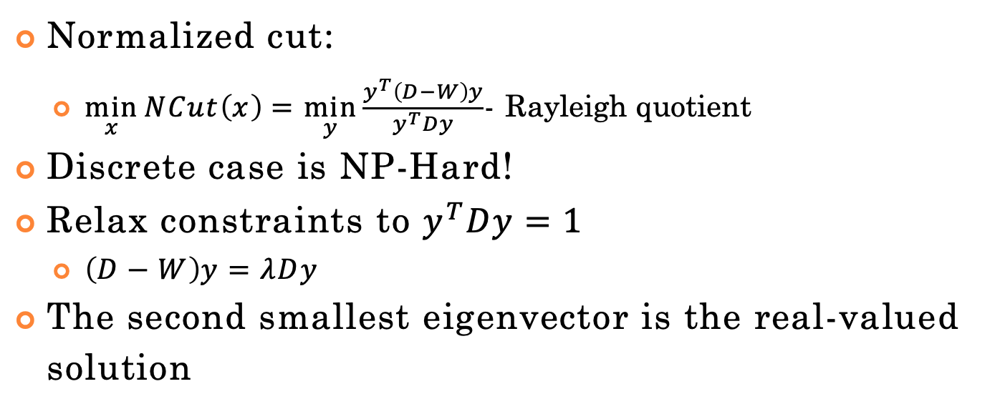
Spectral Clustering
Normalized cut:
$\min_{x}{NCut\left(x\right)}=\min_{y}{\frac{y^{T}\left(D−W\right)y}{y^{T}Dy}}$- Rayleigh quotient
Discrete case is NP-Hard!
Relax constraints to $y^{T}Dy=1$
$\left(D−W\right)y=λDy$
The second smallest eigenvector is the real-valued solution
9

Slide 44
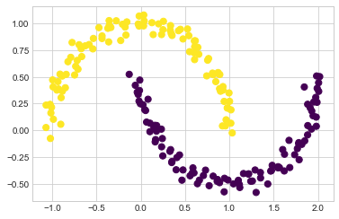
Spectral Clustering
9

Slide 45
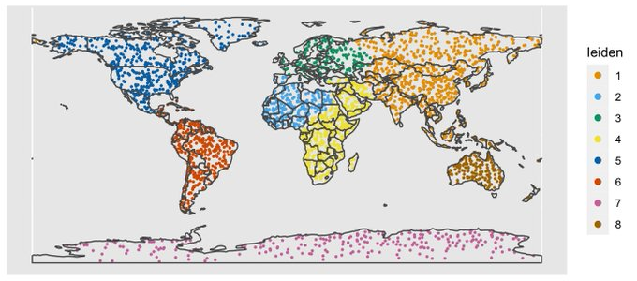
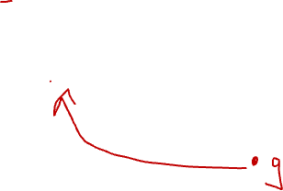
Leiden Clustering Example
https://github.com/lambdamoses/umap_globe
12

Slide 46
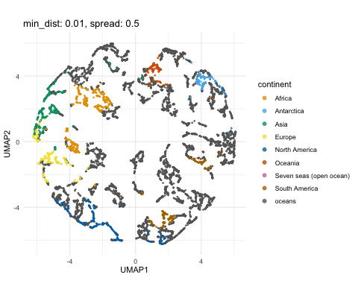
UMAP + Leiden Clustering Example
12
https://github.com/lambdamoses/umap_globe

Slide 47
Scikit-Learn
http://scikit- learn.org/stable/modules/clustering.html
10

